Slide 1


CS-429 Introduction to Data Science
Lecture – 05, Linear Regression
Fall 2024

Slide 2
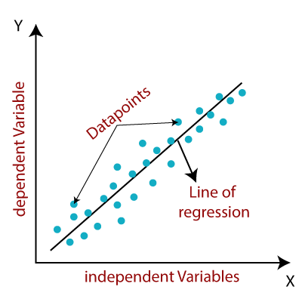
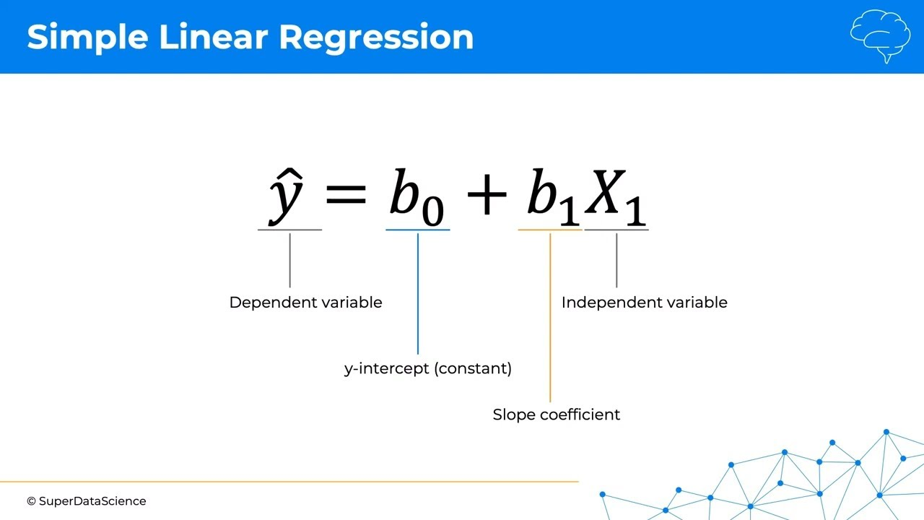
Linear Regression
It is the supervised machine learning algorithm that computes the linear relationship between the dependent variable and one or more independent features by fitting a linear equation to observed data/ Feed data/ input samples/ dataset.

Slide 3
Formula of LR
Independent Variable
Dependent Variable

Slide 4
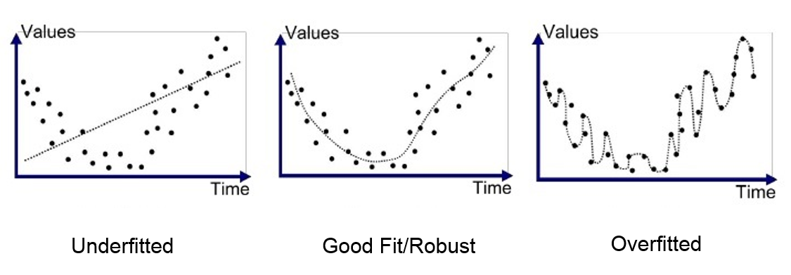
Linear Regression
Linear regression is used to predict the value of one variable based on the value of another.
The method draws a line through the data points that best represents the relationship between the variables.
Linear regression is one of the simplest and most interpretable methods in machine learning.

Slide 5
Types of LR
Simple Linear Regression: Involves one input variable and one output variable. It tries to find the relationship between these two.
2. Multiple Linear Regression: Involves more than one input variable. It predicts the output based on multiple inputs, finding a line in higher dimensions

Slide 6
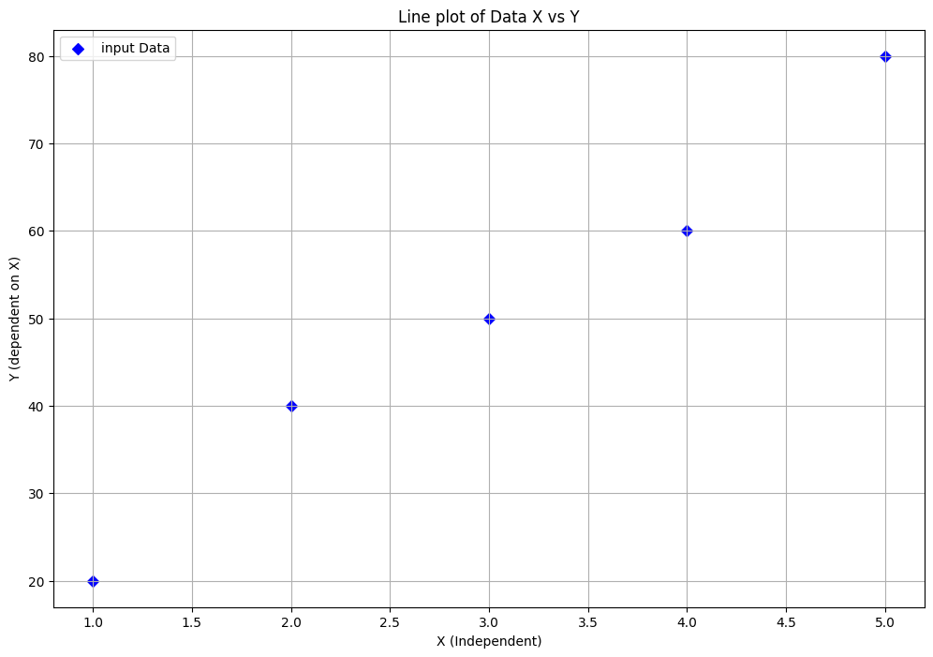
Simple LR Example
Linear regression equation to predict a student’s score based on hours studied.
Hours Studied (x) | Score (y)
1 | 20
2 | 40
3 | 50
4 | 60
5 | 80
where:
𝑦 is the predicted score,
𝑥 is the hours studied,
b0 is the intercept,
b1 is the slope

Slide 7
Lab (matplotlib)
import numpy as np
import matplotlib.pyplot as plt
x = [1, 2, 3, 4, 5 ]
y1 = [20, 40, 50, 60, 80]
plt.figure(figsize=(12, 8))
plt.scatter(x, y1, color='blue', marker='D', label='input Data')
plt.title('Line plot of Data X vs Y')
plt.xlabel('X (Independent)')
plt.ylabel('Y (dependent on X)')
plt.legend()
plt.grid(True)
# Display the plot
plt.show()

Slide 8
Simple LR Example
Hours Studied (x) | Score (y)
1 | 20
2 | 40
3 | 50
4 | 60
5 | 80
15/5 = 3 | 250/5 = 50
First, Calculate the Slope

Slide 9
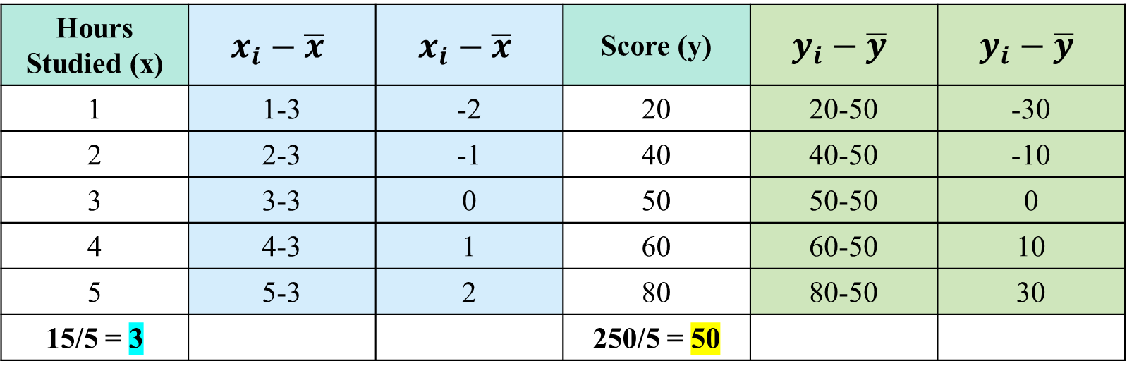
Simple LR Example
First, Calculate the Slope
Hours Studied (x) | $$x_{i}−\overline{x}$$ | $$x_{i}−\overline{x}$$ | Score (y) | $$y_{i}−\overline{y}$$ | $$y_{i}−\overline{y}$$
1 | 1-3 | -2 | 20 | 20-50 | -30
2 | 2-3 | -1 | 40 | 40-50 | -10
3 | 3-3 | 0 | 50 | 50-50 | 0
4 | 4-3 | 1 | 60 | 60-50 | 10
5 | 5-3 | 2 | 80 | 80-50 | 30
15/5 = 3 |  |  | 250/5 = 50

Slide 10
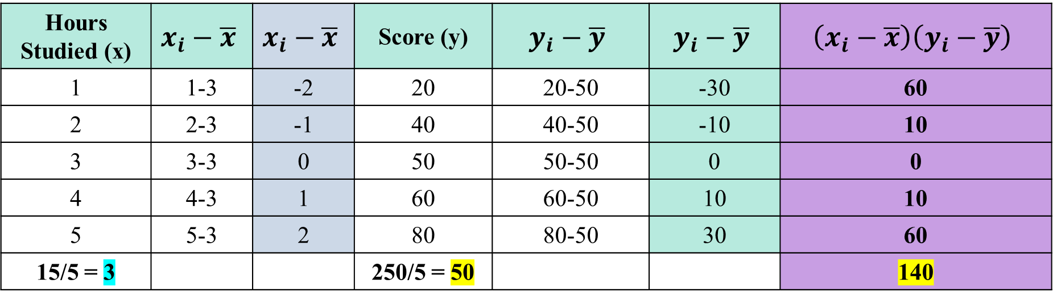
Simple LR Example
First, Calculate the Slope
Hours Studied (x) | $$x_{i}−\overline{x}$$ | $$x_{i}−\overline{x}$$ | Score (y) | $$y_{i}−\overline{y}$$ | $$y_{i}−\overline{y}$$ | $$\left(x_{i}−\overline{x}\right)\left(y_{i}−\overline{y}\right)$$
1 | 1-3 | -2 | 20 | 20-50 | -30 | 60
2 | 2-3 | -1 | 40 | 40-50 | -10 | 10
3 | 3-3 | 0 | 50 | 50-50 | 0 | 0
4 | 4-3 | 1 | 60 | 60-50 | 10 | 10
5 | 5-3 | 2 | 80 | 80-50 | 30 | 60
15/5 = 3 |  |  | 250/5 = 50 |  |  | 140

Slide 11
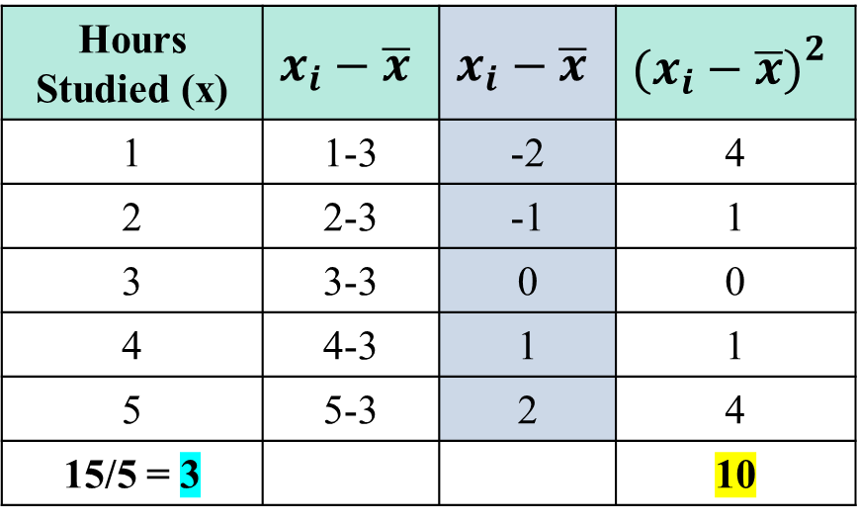
Simple LR Example
First, Calculate the Slope
Hours Studied (x) | $$x_{i}−\overline{x}$$ | $$x_{i}−\overline{x}$$ | $${\left.\left.(\right.x_{i}−\overline{x})\right.}^{2}$$
1 | 1-3 | -2 | 4
2 | 2-3 | -1 | 1
3 | 3-3 | 0 | 0
4 | 4-3 | 1 | 1
5 | 5-3 | 2 | 4
15/5 = 3 |  |  | 10

Slide 12
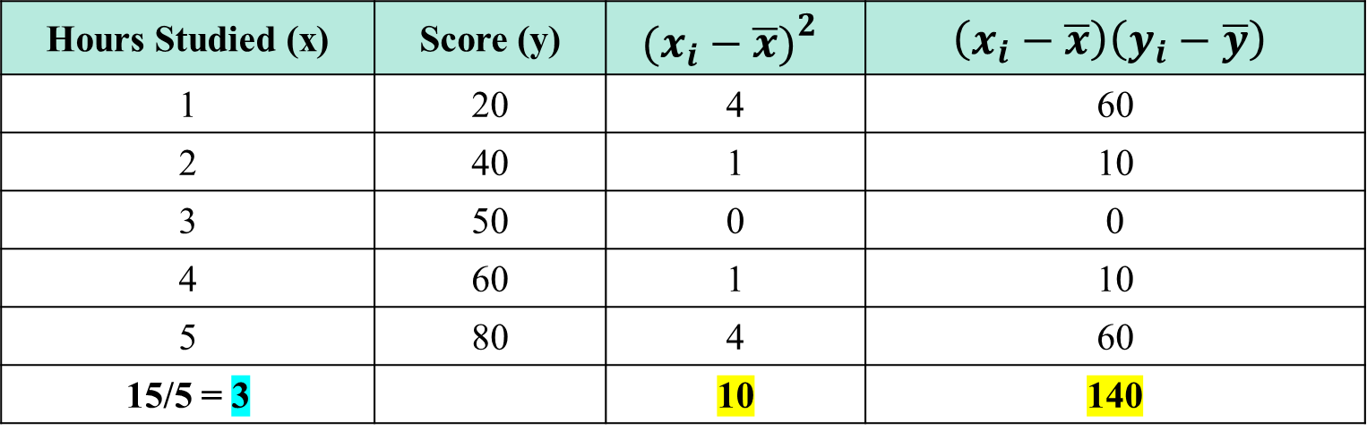
Simple LR Example
First, Calculate the Slope
Hours Studied (x) | Score (y) | $${\left.\left.(\right.x_{i}−\overline{x})\right.}^{2}$$ | $$\left(x_{i}−\overline{x}\right)\left(y_{i}−\overline{y}\right)$$
1 | 20 | 4 | 60
2 | 40 | 1 | 10
3 | 50 | 0 | 0
4 | 60 | 1 | 10
5 | 80 | 4 | 60
15/5 = 3 |  | 10 | 140

Slide 13
Simple LR Example
2nd, Calculate the intercept

Slide 14
Simple LR Example
3nd, Calculate the dependent Y Variable if independent X=6
Answer: 92

Slide 15
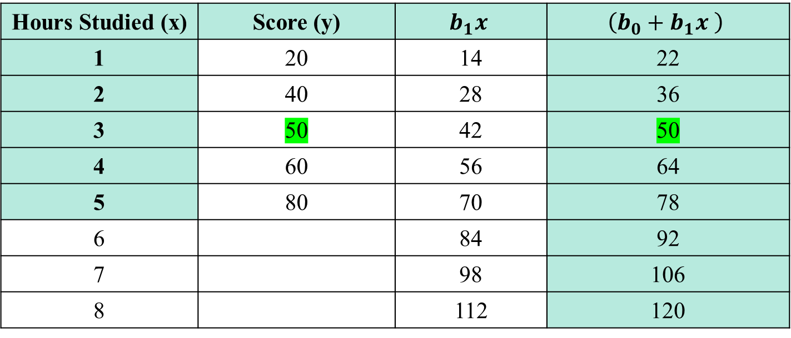
Simple LR Example
Verify the existing samples
Hours Studied (x) | Score (y) | $$b_{1}x$$ | $$\left(b_{0}+b_{1}x \right)$$
1 | 20 | 14 | 22
2 | 40 | 28 | 36
3 | 50 | 42 | 50
4 | 60 | 56 | 64
5 | 80 | 70 | 78
6 |  | 84 | 92
7 |  | 98 | 106
8 |  | 112 | 120

Slide 16
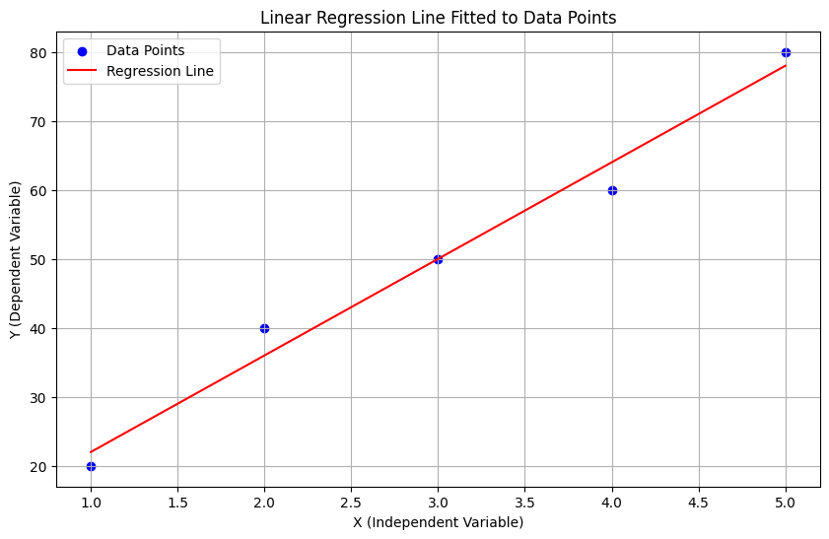
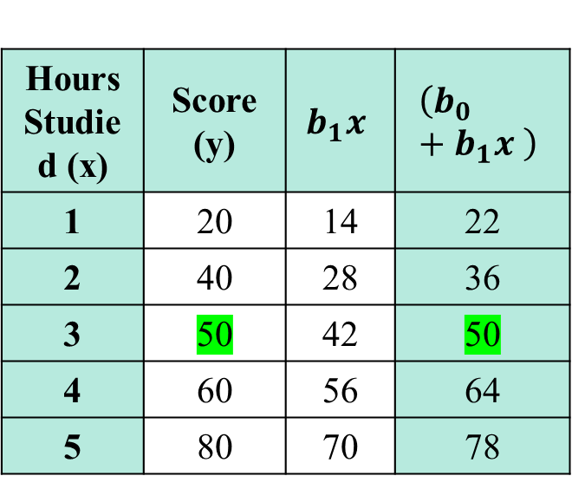
Lab
Hours Studied (x) | Score (y) | $$b_{1}x$$ | $$\left(b_{0}+b_{1}x \right)$$
1 | 20 | 14 | 22
2 | 40 | 28 | 36
3 | 50 | 42 | 50
4 | 60 | 56 | 64
5 | 80 | 70 | 78

Slide 17
Lab
import numpy as np
import matplotlib.pyplot as plt
from sklearn.linear_model import LinearRegression
X = np.array([1, 2, 3, 4, 5 ]).reshape(-1, 1) # Reshape for sklearn
Y = np.array([20, 40, 50, 60, 80])
model = LinearRegression()
model.fit(X, Y)
Y_pred = model.predict(X)
plt.figure(figsize=(10, 6))
plt.scatter(X, Y, color="blue", label="Data Points")
# Plot the regression line
plt.plot(X, Y_pred, color="red", label="Regression Line")
plt.xlabel("X (Independent Variable)")
plt.ylabel("Y (Dependent Variable)")
plt.title("Linear Regression Line Fitted to Data Points")
plt.legend()
plt.grid(True)
plt.show()

Slide 18
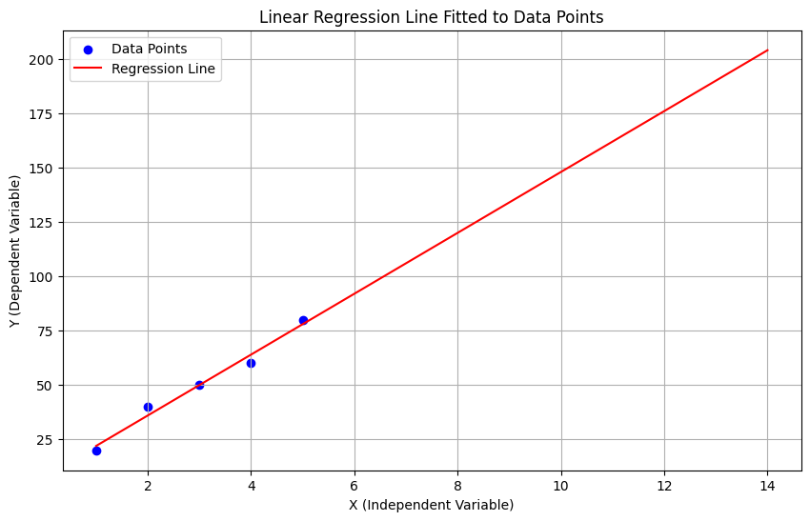
Lab (extending the predictions and plotting them)
X2 = np.array([1, 2, 3, 4, 5 , 6, 7, 8, 9, 10, 14 ]).reshape(-1, 1) # Reshape for sklearn
Y_pred = model.predict(X2)
print(len(X2))
print(len(Y_pred))
plt.figure(figsize=(10, 6))
plt.scatter(X2[:len(Y)], Y, color="blue", label="Data Points")
# Plot the regression line
plt.plot(X2, Y_pred, color="red", label="Regression Line")
plt.xlabel("X (Independent Variable)")
plt.ylabel("Y (Dependent Variable)")
plt.title("Linear Regression Line Fitted to Data Points")
plt.legend()
plt.grid(True)
plt.show()

Slide 19
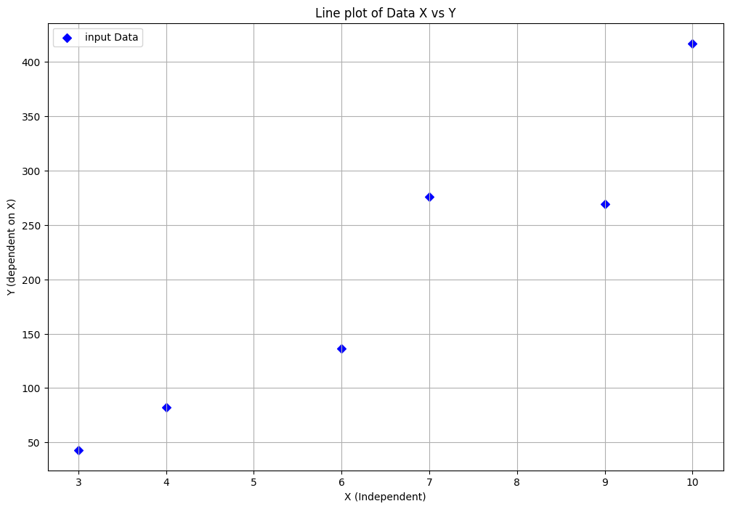
LR Example 2
You have the given data
x | y
7 | 276
3 | 43
4 | 82
6 | 136
10 | 417
9 | 269

Slide 20
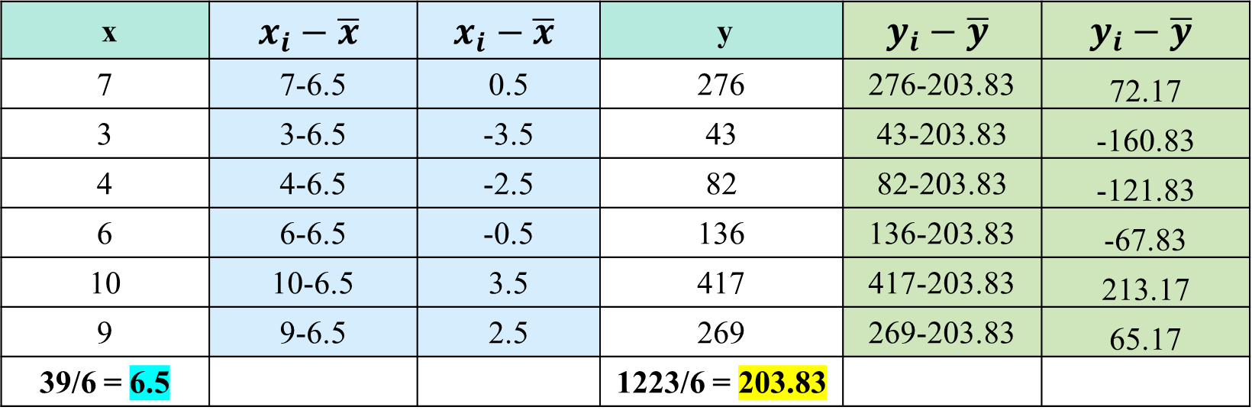
Simple LR Example
First, Calculate the Slope
x | $$x_{i}−\overline{x}$$ | $$x_{i}−\overline{x}$$ | y | $$y_{i}−\overline{y}$$ | $$y_{i}−\overline{y}$$
7 | 7-6.5 | 0.5 | 276 | 276-203.83 | 72.17
3 | 3-6.5 | -3.5 | 43 | 43-203.83 | -160.83
4 | 4-6.5 | -2.5 | 82 | 82-203.83 | -121.83
6 | 6-6.5 | -0.5 | 136 | 136-203.83 | -67.83
10 | 10-6.5 | 3.5 | 417 | 417-203.83 | 213.17
9 | 9-6.5 | 2.5 | 269 | 269-203.83 | 65.17
39/6 = 6.5 |  |  | 1223/6 = 203.83

Slide 21
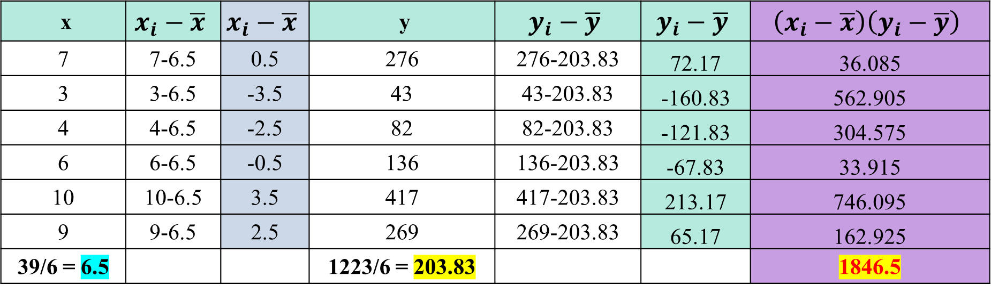
LR Example 2
First, Calculate the Slope
x | $$x_{i}−\overline{x}$$ | $$x_{i}−\overline{x}$$ | y | $$y_{i}−\overline{y}$$ | $$y_{i}−\overline{y}$$ | $$\left(x_{i}−\overline{x}\right)\left(y_{i}−\overline{y}\right)$$
7 | 7-6.5 | 0.5 | 276 | 276-203.83 | 72.17 | 36.085
3 | 3-6.5 | -3.5 | 43 | 43-203.83 | -160.83 | 562.905
4 | 4-6.5 | -2.5 | 82 | 82-203.83 | -121.83 | 304.575
6 | 6-6.5 | -0.5 | 136 | 136-203.83 | -67.83 | 33.915
10 | 10-6.5 | 3.5 | 417 | 417-203.83 | 213.17 | 746.095
9 | 9-6.5 | 2.5 | 269 | 269-203.83 | 65.17 | 162.925
39/6 = 6.5 |  |  | 1223/6 = 203.83 |  |  | 1846.5

Slide 22
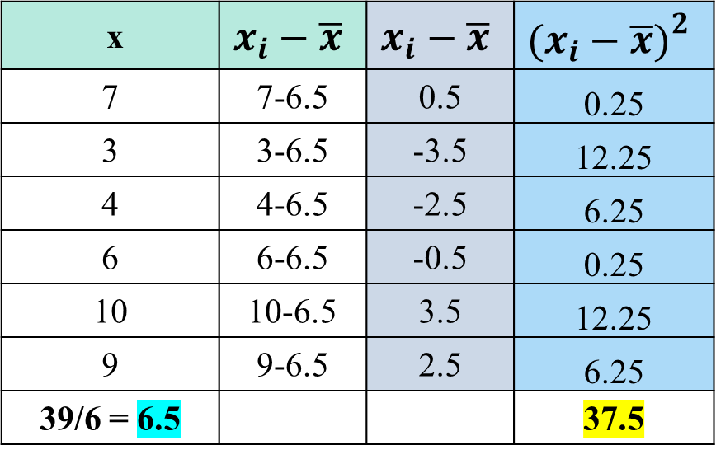
LR Example 2
First, Calculate the Slope
x | $$x_{i}−\overline{x}$$ | $$x_{i}−\overline{x}$$ | $${\left.\left.(\right.x_{i}−\overline{x})\right.}^{2}$$
7 | 7-6.5 | 0.5 | 0.25
3 | 3-6.5 | -3.5 | 12.25
4 | 4-6.5 | -2.5 | 6.25
6 | 6-6.5 | -0.5 | 0.25
10 | 10-6.5 | 3.5 | 12.25
9 | 9-6.5 | 2.5 | 6.25
39/6 = 6.5 |  |  | 37.5

Slide 23
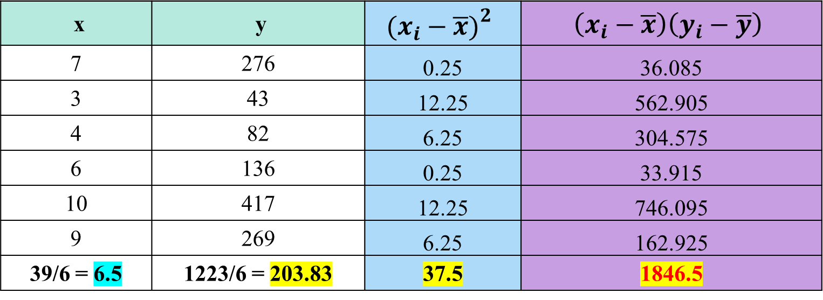
LR Example 2
Putting values in the slope formula
x | y | $${\left.\left.(\right.x_{i}−\overline{x})\right.}^{2}$$ | $$\left(x_{i}−\overline{x}\right)\left(y_{i}−\overline{y}\right)$$
7 | 276 | 0.25 | 36.085
3 | 43 | 12.25 | 562.905
4 | 82 | 6.25 | 304.575
6 | 136 | 0.25 | 33.915
10 | 417 | 12.25 | 746.095
9 | 269 | 6.25 | 162.925
39/6 = 6.5 | 1223/6 = 203.83 | 37.5 | 1846.5

Slide 24
LR Example 2
2nd, Calculate the intercept

Slide 25
LR Example 2
3nd, Calculate the dependent Y Variable if independent X=14
Answer: 573.36

Slide 26
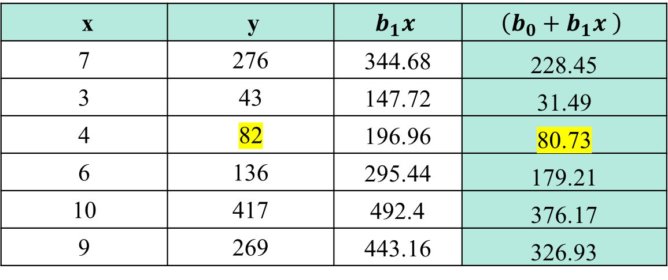
LR Example 2
x | y | $$b_{1}x$$ | $$\left(b_{0}+b_{1}x \right)$$
7 | 276 | 344.68 | 228.45
3 | 43 | 147.72 | 31.49
4 | 82 | 196.96 | 80.73
6 | 136 | 295.44 | 179.21
10 | 417 | 492.4 | 376.17
9 | 269 | 443.16 | 326.93

Slide 27
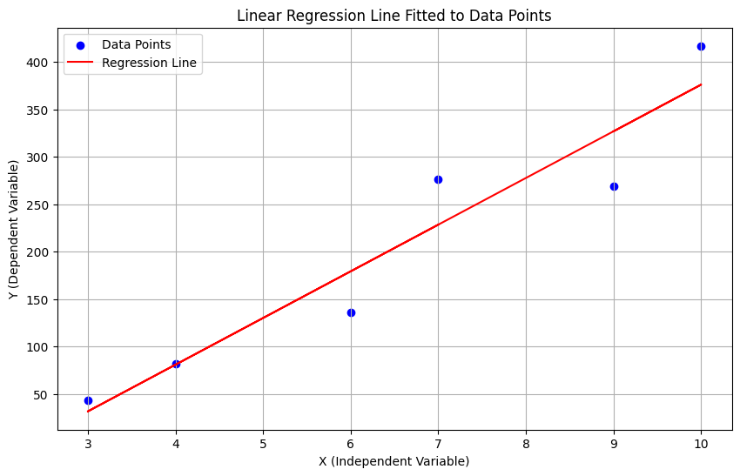
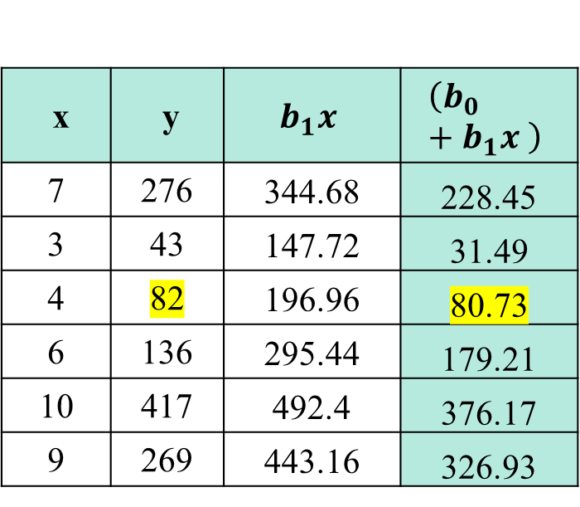
Lab 2
x | y | $$b_{1}x$$ | $$\left(b_{0}+b_{1}x \right)$$
7 | 276 | 344.68 | 228.45
3 | 43 | 147.72 | 31.49
4 | 82 | 196.96 | 80.73
6 | 136 | 295.44 | 179.21
10 | 417 | 492.4 | 376.17
9 | 269 | 443.16 | 326.93

Slide 28
Lab 2
import numpy as np
import matplotlib.pyplot as plt
from sklearn.linear_model import LinearRegression
X = np.array([7, 3, 4, 6, 10, 9]).reshape(-1, 1) # Reshape for sklearn
Y = np.array([276, 43, 82, 136, 417, 269])
model = LinearRegression()
model.fit(X, Y)
Y_pred = model.predict(X)
plt.figure(figsize=(10, 6))
plt.scatter(X, Y, color="blue", label="Data Points")
# Plot the regression line
plt.plot(X, Y_pred, color="red", label="Regression Line")
plt.xlabel("X (Independent Variable)")
plt.ylabel("Y (Dependent Variable)")
plt.title("Linear Regression Line Fitted to Data Points")
plt.legend()
plt.grid(True)
plt.show()

Slide 29
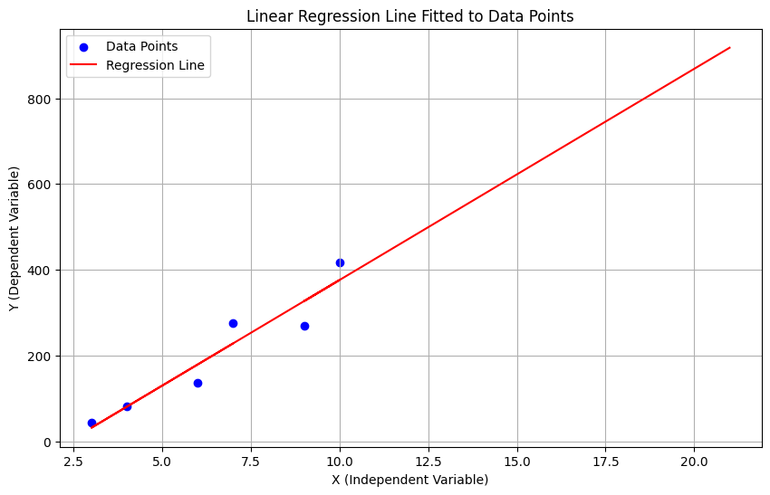
Lab 2 (extending the predictions and plotting them)
X2 = np.array([7, 3, 4, 6, 10, 9, 12, 17, 21]).reshape(-1, 1) # Reshape for sklearn
Y_pred = model.predict(X2)
print(len(X2))
print(len(Y_pred))
plt.figure(figsize=(10, 6))
plt.scatter(X2[:len(Y)], Y, color="blue", label="Data Points")
# Plot the regression line
plt.plot(X2, Y_pred, color="red", label="Regression Line")
plt.xlabel("X (Independent Variable)")
plt.ylabel("Y (Dependent Variable)")
plt.title("Linear Regression Line Fitted to Data Points")
plt.legend()
plt.grid(True)
plt.show()

Slide 30


Slide 31

Jannah: Home at Last, a Yaqeen Series with Dr. Omar Suleiman
URL: Ramadan 2023 | Jannah: Home at Last, a Yaqeen Series with Dr. Omar Suleiman | #Jannah #RamadanSeries
Number of episodes: 30
Total Duration: 05 ~ 06 Hrs

